Slide 1
Optimizing Word Embeddings

Slide 2
Sparse Representation
  ACL15-CMU-Sparse Overcomplete Word Vector Representations
  ACL16-PKU-Compressing Neural Language Models by Sparse Word Representations
Incorporating Semantics
  ACL16-Yandex-Siamese CBOW Optimizing Word Embeddings for Sentence Representations
  NAACL16-USTC-Improve Chinese Word Embeddings by Exploiting Internal Structure

Slide 3
ACL15-CMU-Sparse Overcomplete Word Vector Representations
- What is Overcomplete Representation?
- Why need Sparse?
- Feature Selection
- Interpretable

Slide 4
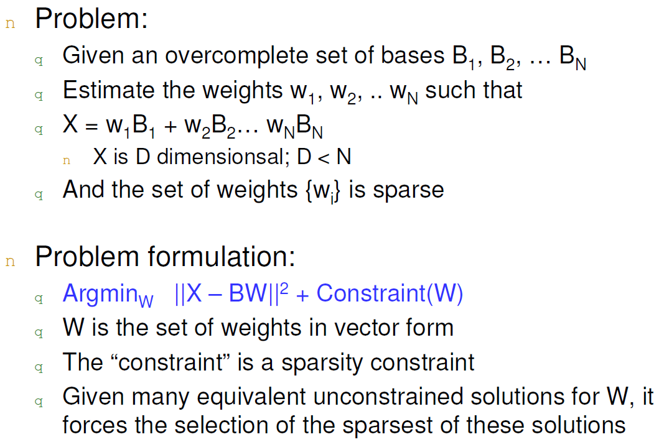
Sparse Coding

Slide 5
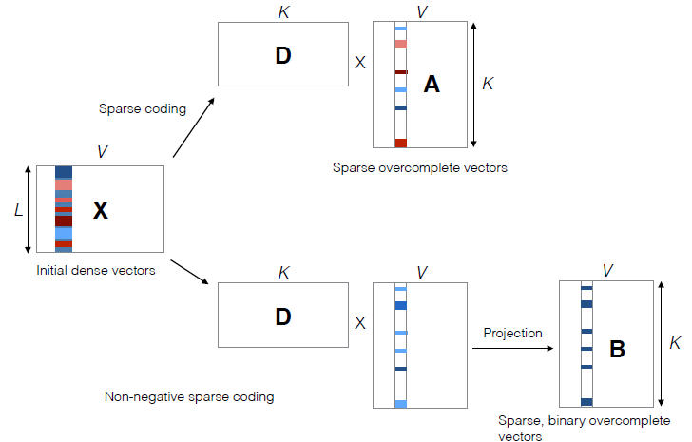
Sparse Overcomplete
Word Vectors

Slide 6

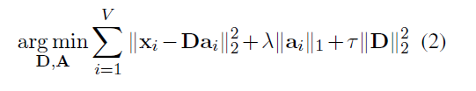
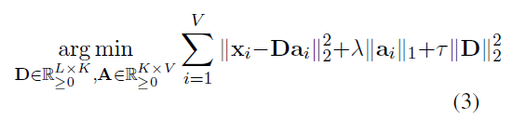

Sparse Overcomplete
Word Vectors
Method A:
Method B:

Slide 7
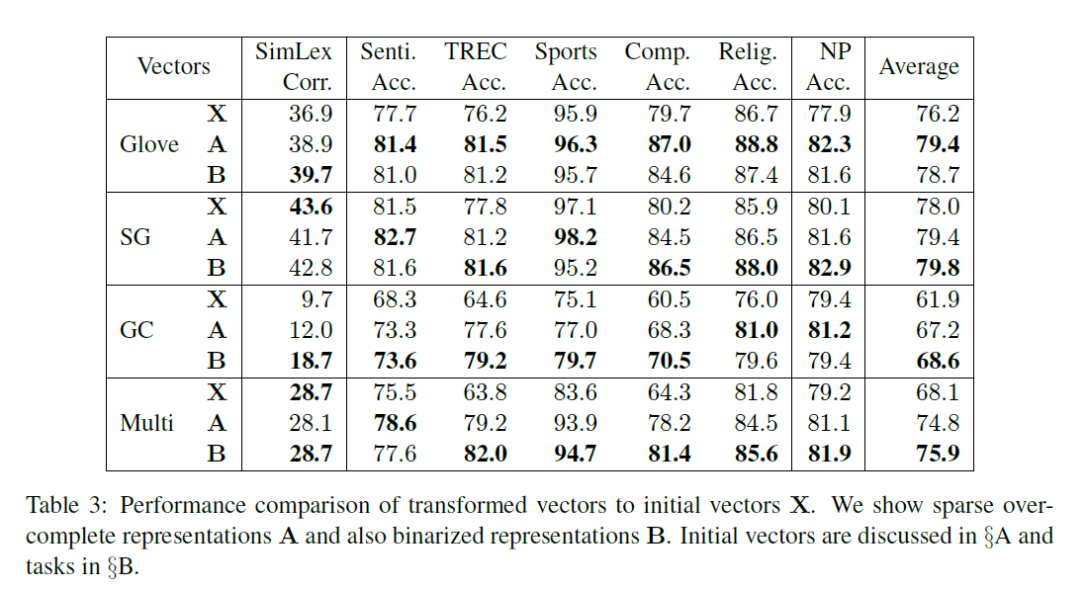
Experiments

Slide 8
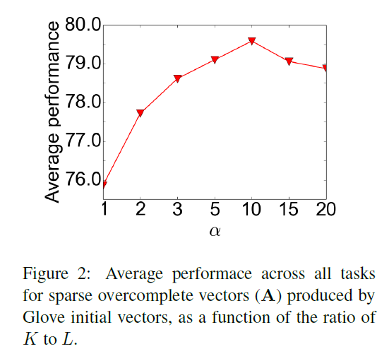
Experiments

Slide 9
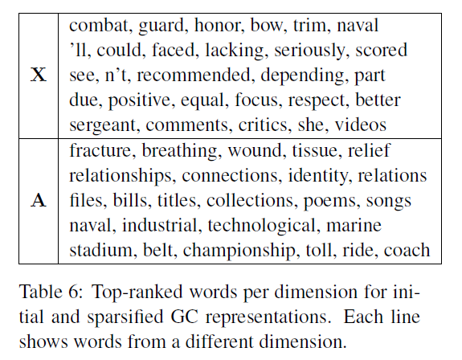
Qualitative Evaluation of Interpretability

Slide 10
ACL16-PKU-Compressing Neural Language Models by Sparse Word Representations
- Why Spare?
- Too memory consuming
- Neural Language Models are unlikely to learn infrequent words
- infrequent words’ gradient is only occasionally computed during training

Slide 11
ACL16-PKU-Compressing Neural Language Models by Sparse Word Representations
- Why Spare?
- Too memory consuming
- Neural Language Models are unlikely to learn infrequent words
- infrequent words’ gradient is only occasionally computed during training
- Motivation
- In a dictionary, an unfamiliar word is typically defined by common words.

Slide 12
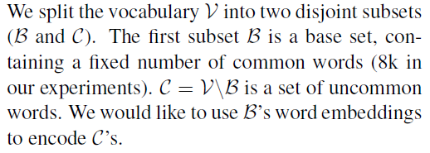
ACL16-PKU-Compressing Neural Language Models by Sparse Word Representations
- In a dictionary, an unfamiliar word is typically defined by common words.
-

Slide 13




Model
- is the learned embedding matrix of common words (e.g., word2vec)
- B is a one hot vector
- For a word in C,
-
- Loss

Slide 14
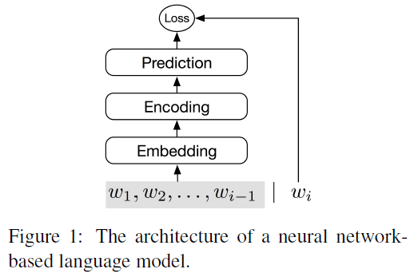
Compressing
Neural Language Models

Slide 15
ACL16-Yandex-Siamese CBOW Optimizing Word Embeddings for Sentence Representations
- are not optimized for sentence representation
- predict a sentence from its adjacent sentences
with the sentence information

Slide 16
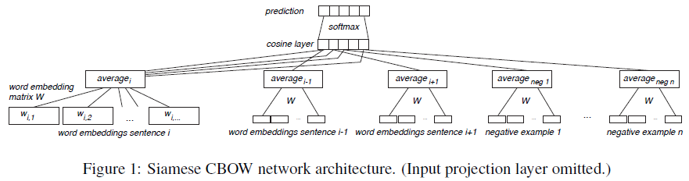
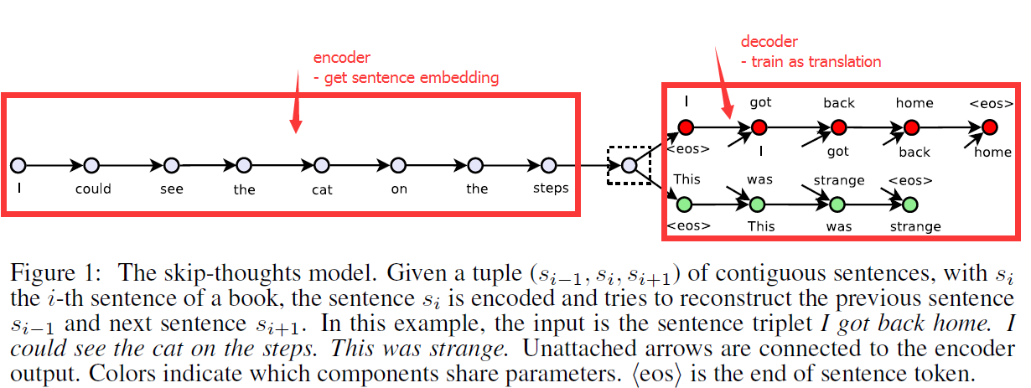

Slide 17
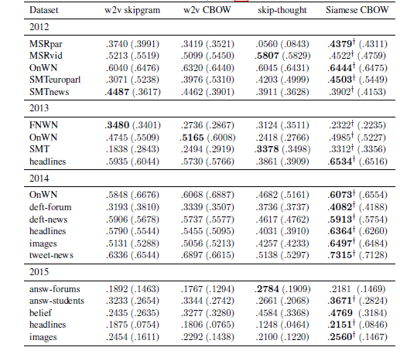
Experiments

Slide 18
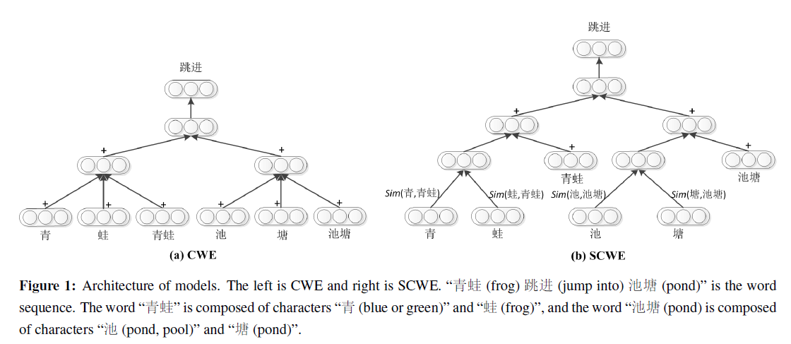
Improve Chinese Word Embeddings by Exploiting Internal Structure

Slide 19
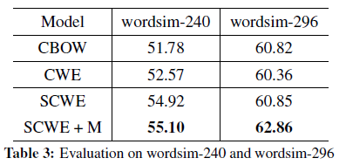
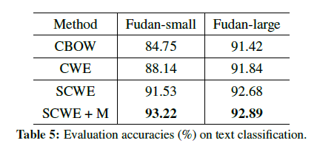
Experiments

Slide 20
Hierarchical Attentive Memory

Slide 21
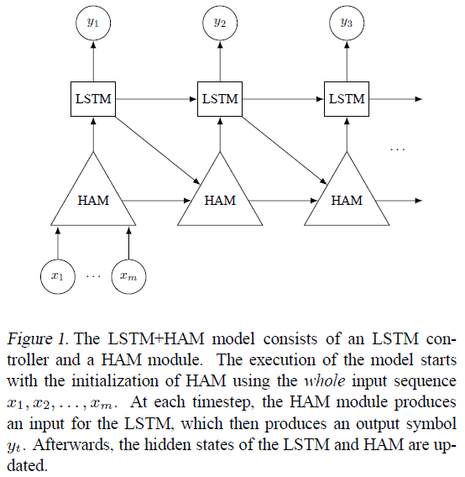
Abstract
based on a binary tree
perform memory access in O(logn)
learning algorithms for problems
e.g., merging, sorting, binary searching
act like classic data structures
e.g., stack, FIFO, priority queue

Slide 22
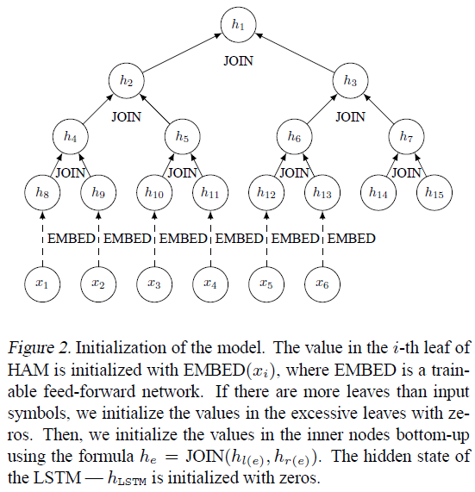
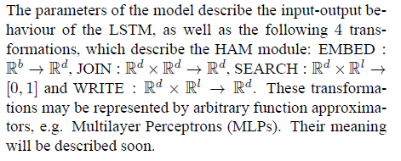
Inference

Slide 24
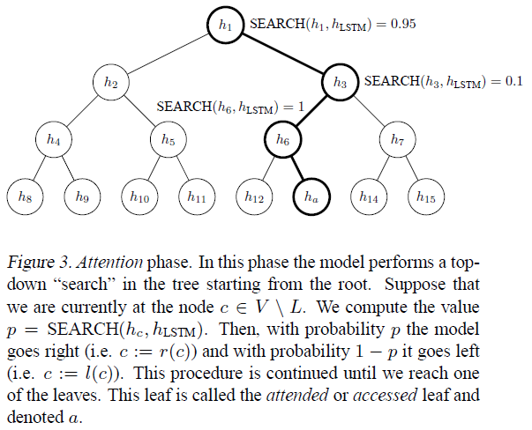

Slide 26
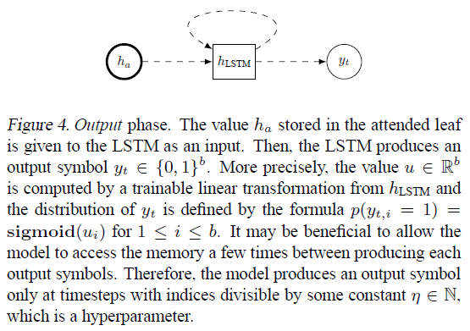

Slide 27
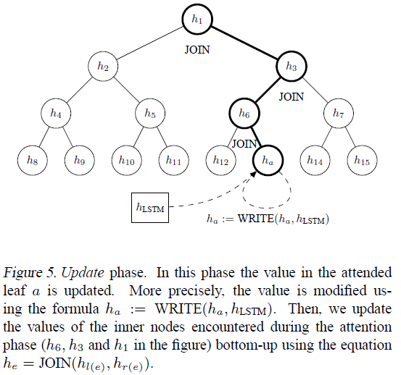

Slide 28
Training
- Hard attention
REINFORCE
- Soft attention
compute for every leaf e the probability p(e)

Slide 29
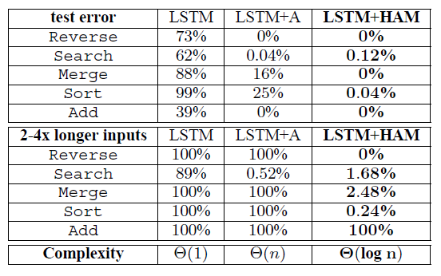
Experiments

